Slide 1
Linux device driver
Day 36 PPT
-SUBITHRA s

Slide 2
Overview of data structures

Slide 3
Block Drivers
Provides access to devices that transfer randomly accessible data in blocks, or fixed size chunks of data (e.g., 4KB)
Note that underlying HW uses sectors (e.g., 512B)
Bridge core memory and secondary storage
Performance is essential
Or the system cannot perform well
Lecture example: sbull (Simple Block Device)
A ramdisk

Slide 4
Block driver registration
To register a block device, call
int register_blkdev(unsigned int major,
const char *name);
major: major device number
If 0, kernel will allocate and return a new major number
name: as displayed in /proc/devices
To unregister, call
int unregister_blkdev(unsigned int major,
const char *name);

Slide 5
Disk registration
register_blkdev
Obtains a major number
Does not make disk drives available to the system
Need additional mechanisms to register a disk
Need to know two data structures:
struct block_device_operations
Defined in <linux/blkdev.h>
struct gendisk
Defined in <linux/genhd.h>

Slide 6
Block device operations
struct block_device_operations is similar to file_operations
Important fields
/* may need to lock the door for removal media; unlock in the release method; may need to spin the disk up or down */
int (*open) (struct block_device *dev,
fmode_t mode);
int (*release) (struct gendisk *gd,
fmode_t mode);

Slide 7
Block device operations
int (*ioctl) (struct block_dev *bdev,
fmode_t mode,
unsigned int cmd,
unsigned long long arg);
/* check whether the media has been changed; gendisk represents a disk */
int (*media_changed) (struct gendisk *gd);
/* makes new media ready to use */
int (*revalidate_disk) (struct gendisk *gd);
struct module *owner; /* = THIS_MODULE */

Slide 8
The gendisk structure
struct gendisk represents a disk or a partition
Must initialize the following fields
int major;
int first_minor;
/* need one minor number per partition */
int minors;
/* as shown in /proc/partitions & sysfs */
char disk_name[32];

Slide 9
The gendisk structure
struct block_device_operations *fops;
/* holds I/O requests for this device */
struct request_queue *queue;
/* set to GENHD_FL_REMOVABLE for removal media; GENGH_FL_CD for CD-ROMs */
int flags;
/* in 512B sectors; use set_capacity() */
sector_t capacity;

Slide 10
The gendisk structure
/* pointer to internal data */
void *private data;

Slide 11
The gendisk structure
To allocate, call
struct gendisk *alloc_disk(int minors);
minors: number of minor numbers for this disk; cannot be changed later
To deallocate, call
void del_gendisk(struct gendisk *gd);
To make disk available to the system, call
void add_disk(struct gendisk *gd);
To make disk unavailable, call
void put_disk(struct gendisk *gd);

Slide 12
The anatomy of a request
The bio structure
Contains everything that a block driver needs to carryout out an IO request
Defined in <linux/bio.h>
Some important fields
/* the first sector in this transfer */
sector_t bi_sector;
/* size of transfer in bytes */
unsigned int bi_size;

Slide 13
The anatomy of a request
/* use bio_data_dir(bio) to check the direction of IOs*/
unsigned long bi_flags;
/* number of segments within this bio */
unsigned short bio_phys_segments;
struct bio_vec {
struct page *bv_page;
unsigned int bv_offset; // within a page
unsigned int bv_len; // of this transfer
}

Slide 14
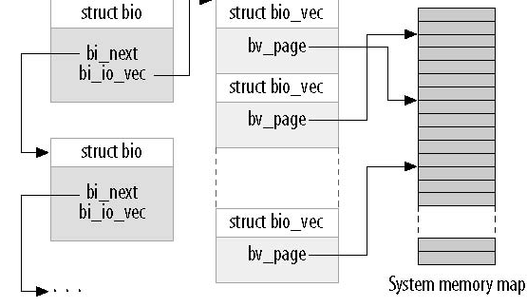
The bio structure

Slide 15
The bio structure
For portability, use macros to operate on bio_vec
int segno;
struct bio_vec *bvec;
bio_for_each_segment(bvec, bio, segno) {
// Do something with this segment
}
Current bio_vec entry

Slide 16
Low-level bio operations
To access the pages directly, use
char *__bio_kmap_atomic(struct bio *bio,
int i,
enum km_type type);
void __bio_kunmap_atomic(char *buffer,
enum km_type type);

Slide 17
Low-level bio macros
/* returns the page to be transferred next */
struct page *bio_page(struct bio *bio);
/* returns the offset within the current page to be transferred */
int bio_offset(struct bio *bio);
/* returns a kernel logical (shifted) address pointing to the data to be transferred; the address should not be in high memory */
char *bio_data(struct bio *bio);

Slide 18
The request structure
A request structure is implemented as a linked list of bio structures, with some additional info
Some important fields
/* first sector that has not been transferred */
sector_t __sector;
/* number of sectors yet to transfer */
unsigned int __data_len;

Slide 19
The request structure
/* linked list of bios, access via rq_for_each_bio */
struct bio *bio;
/* same as calling bio_data() on current bio */
char *buffer;

Slide 20
The request structure
/* number of segments after merging */
unsigned short nr_phys_segments;
struct list_head queuelist;

Slide 21
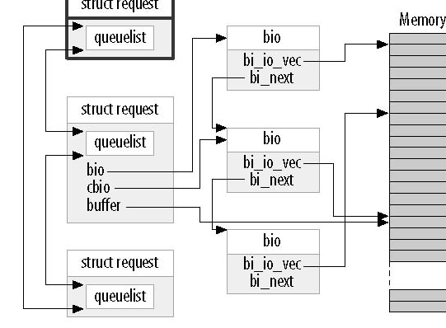
The request structure

Slide 22
Queue control functions
/* if a device cannot handle more pending requests, call */
void blk_stop_queue(request_queue_t *queue);
/* to restart the queue, call */
void blk_start_queue(request_queue_t *queue);
/* set the highest physical address to which a device can perform DMA; the address can also be BLK_BOUNCE_HIGH, BLK_BOUNCE_ISA, or BLK_BOUNCE_ANY */
void
blk_queue_bounce_limit(request_queue_t *queue,
u64 dma_addr);

Slide 23
Request completion functions
After a device has completed transferring the current request chunk, call
bool
__blk_end_request_cur(struct request *req,
int error);
Indicates that the driver has finished transferring count sectors since the last time.
Return false if all sectors in this request have been transferred and the request is complete
Return true if there are still buffers pending

Slide 24
Request processing
Every device is associated with a queue
To read or write a block device, call
void request(request_queue_t *queue);
Runs in an atomic context
Cannot access the current process
May return before completing the request

Slide 25
Working with sbull bios
static void sbull_request(struct request_queue *q)
{
struct request *req;
while ((req = blk_fetch_request(q)) != NULL) {
struct sbull_dev *dev = req->rq_disk->private_data;
sbull_transfer(dev, blk_rq_pos(req), blk_rq_cur_sectors(req), req->buffer, rq_data_dir(req));
__blk_end_request_cur(req, 0);
}
}

Slide 26
THANK YOU

